Slide 1
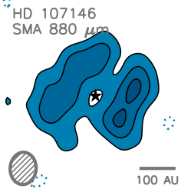

Dynamics of Circumstellar Disks
CO(3-2)
CO(2-1)
¹³CO(2-1)
Turbulence, Magnetic Fields, and Clumps
Meredith Hughes
Miller Fellow, UC Berkeley
David Wilner, Sean Andrews, Jungyeon Cho, Johnathan Williams, Charlie Qi, Catherine Espaillat, Chat Hull, Dick Plambeck, Ram Rao, Dan Marrone, Brian Mason, Michiel Hogerheijde, Gaspard Duchene, John Carpenter, Eugene Chiang

Slide 2
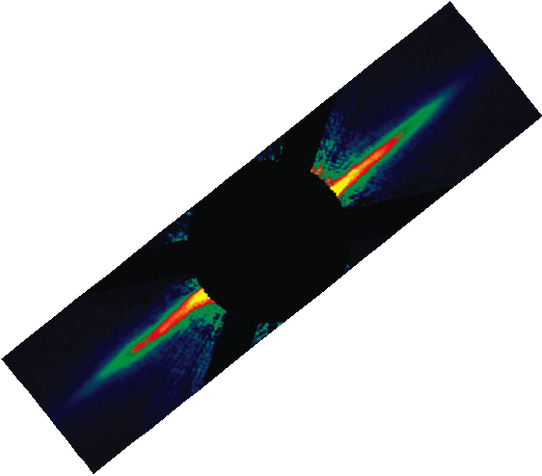
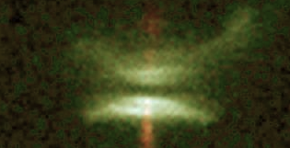
Circumstellar Disk Evolution
Protoplanetary
Pre-MS stars
Gas-rich
Primordial dust
Debris
Main sequence
No (or very little) gas
Dust must be replenished
planets?
HH 30, Burrows et al. 1996
AU Mic, Liu et al. 2004
Some Questions:
What are the conditions in the disk when planets form?
What can we learn about planets from observing disks?

Slide 3
1. Protoplanetary Disks as Accretion Disks
CO(3-2)
CO(2-1)
¹³CO(2-1)

Slide 4
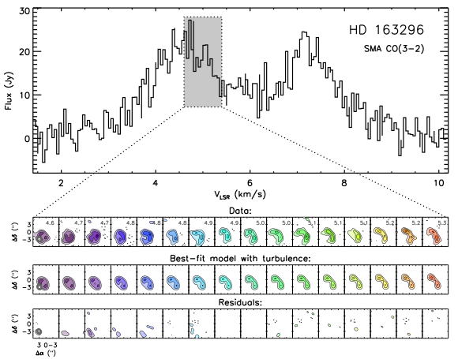
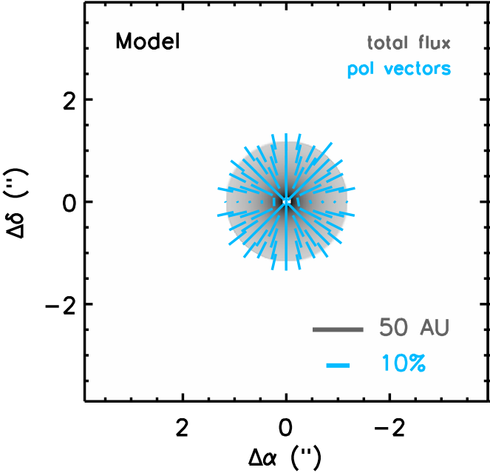
Circumstellar disks as accretion disks
The mass distribution in a disk changes over time as material is transported by viscosity of unspecified origin.
Theories of disk evolution generally invoke MRI-driven turbulence as source of anomalous viscosity.
Balbus & Hawley (1991), Stone et al. (2000)
What is observable?
B-field needed to drive MRI
Aligned dust grains should generate polarized emission
Turbulence that generates viscosity
Nonthermal widths of molecular lines
HD 163296 CO(3-2)

Slide 5
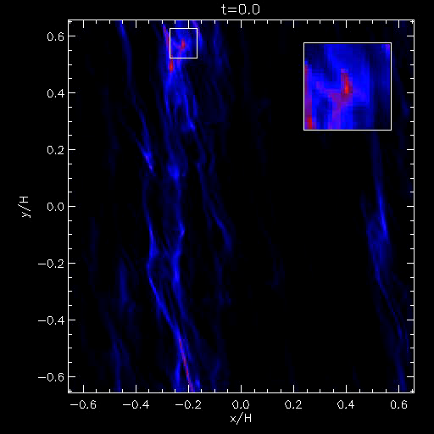
Why should we care?
Turbulence solves (and creates?) problems in planet formation
Time evolution of disk structure
Dust grain transport
Meteoritic mixing
Dust settling
Chemistry
Planetesimal Migration
Johansen et al. (2007)

Slide 6
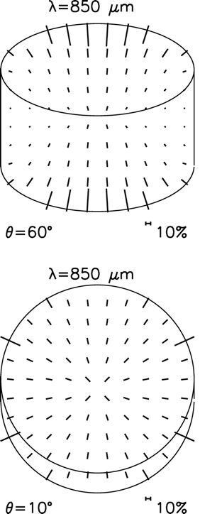
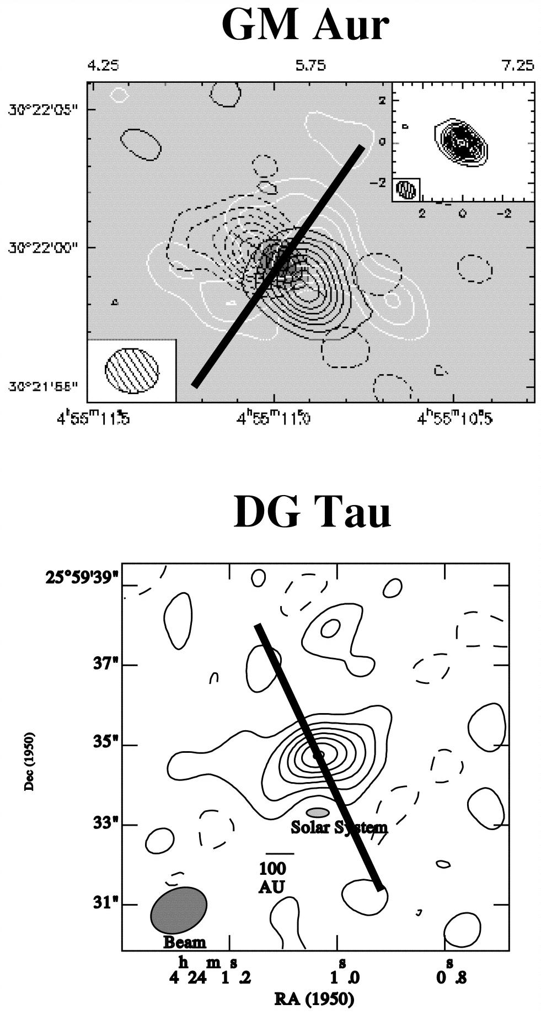
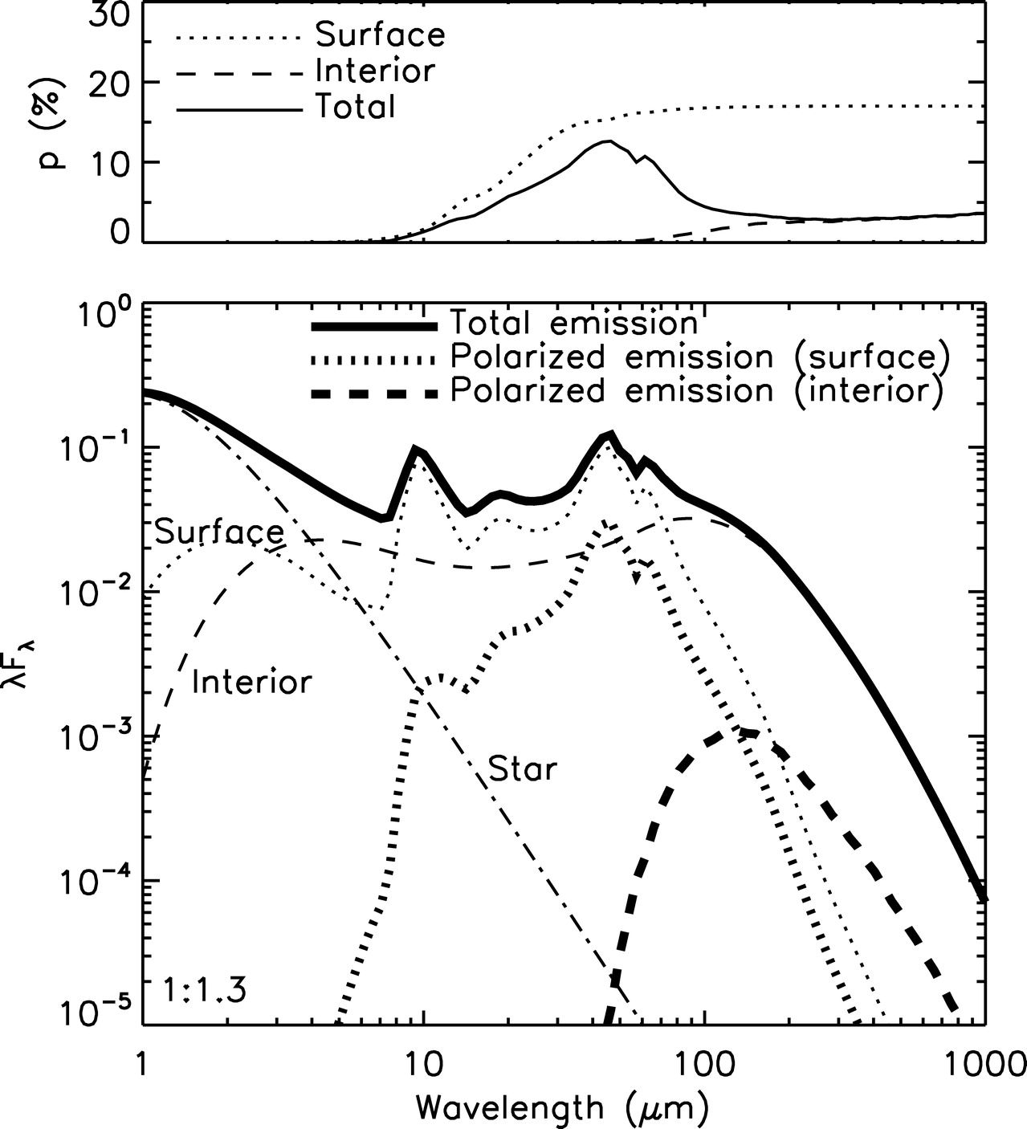
Polarization
Feasibility: single-dish observations, models
Tentative (3σ) 3% polarization detection in two disks with JCMT
First realistic models of polarized emission from disks predict 2-3% polarization at mm wavelengths
Grains aligned by radiative torque
Chiang & Goldreich disk model
Toroidal B-field
Vary grain shape, size dist.
Tamura et al. (1999)
Cho & Lazarian (2007)

Slide 7
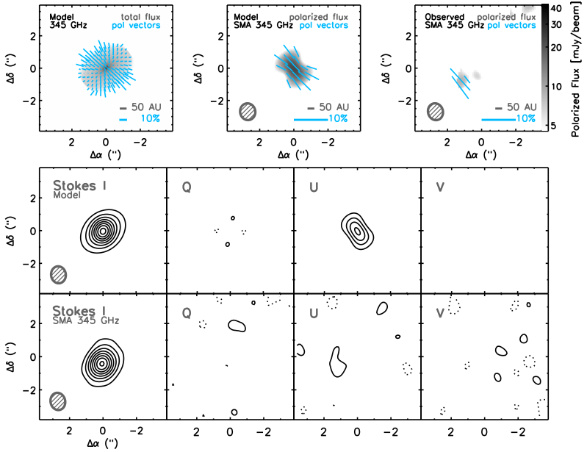
Observations
HD 163296
Hughes et al. (2009)

Slide 8
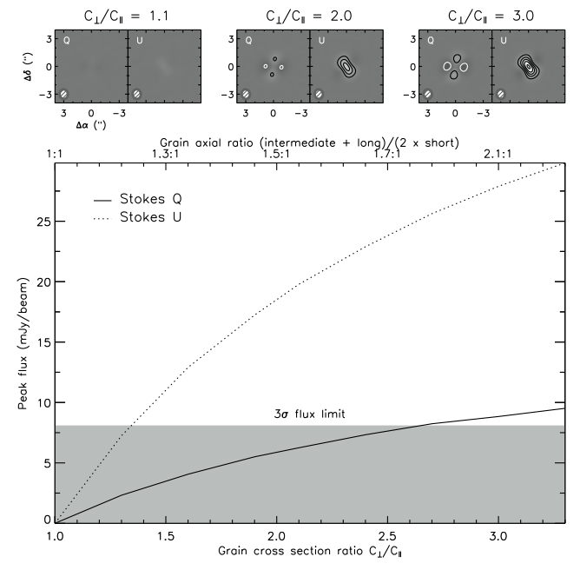
Model Comparison
Observations do not match predictions: what does this tell us?
Identify model inputs that most strongly affect pol %, given Stokes I
1) Grain elongation
2) Alignment efficiency
3) Grain size distribution
4) B-field strength
5) B-field regularity
6) Scattering…
Hughes et al. (2009)

Slide 9
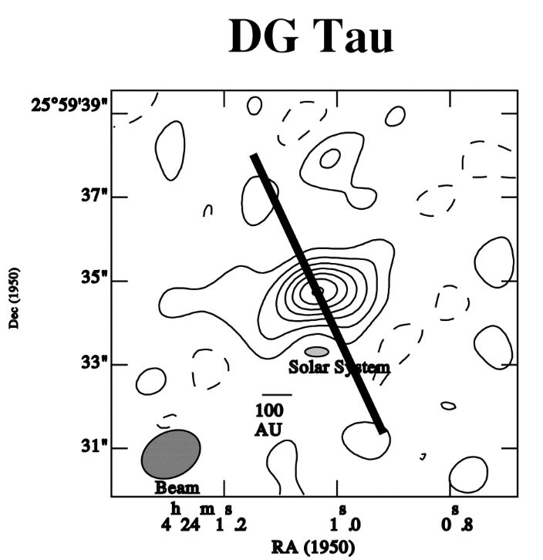
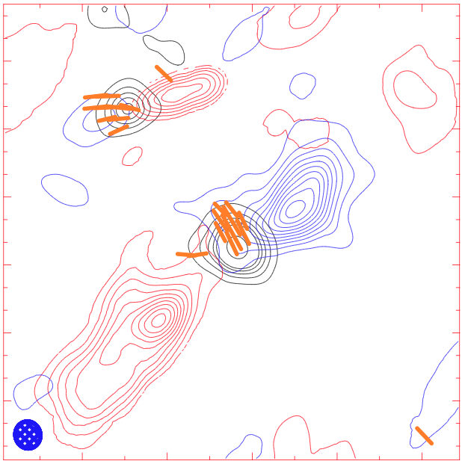
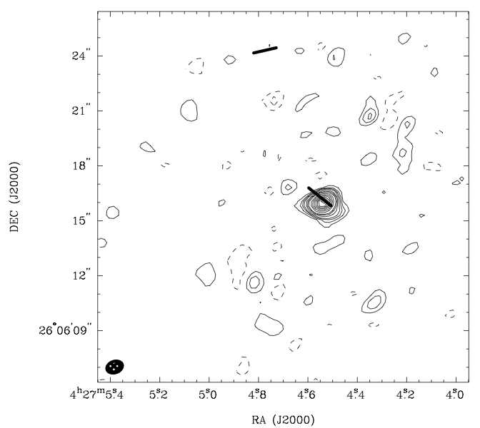
TADPOL (PI: Chat Hull)
A CARMA Key Project starting in the 2012A semester. Emphasis is on outflow/B-field (mis)alignment, but includes interferometric follow-up of DG Tau
HIGHLY PRELIMINARY
Tamura et al. (1999)
C array only. D array to be added any day now.

Slide 10
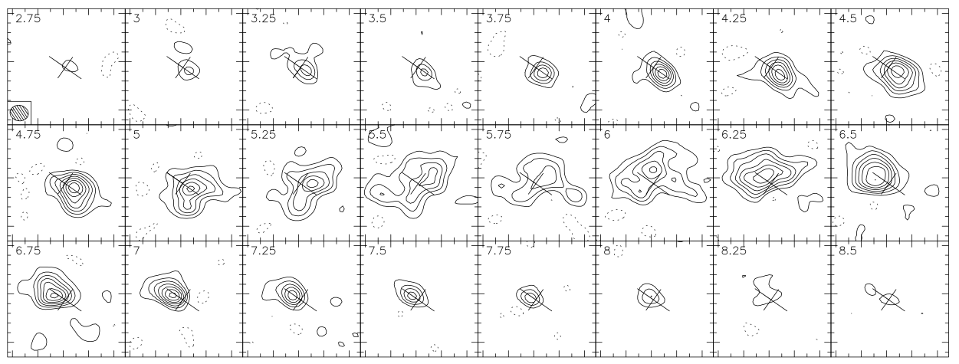
Turbulence
Feasibility: low-res spectra indicate detectable ∆v_{turb}
GM Aur, Dutrey et al. (1998)
“These values should be used as upper limits, since the spectral resolution used for the analysis (0.2 km/s) is comparable to the derived line widths.”
Pietu et al. (2007)
Need better spectral resolution!

Slide 11
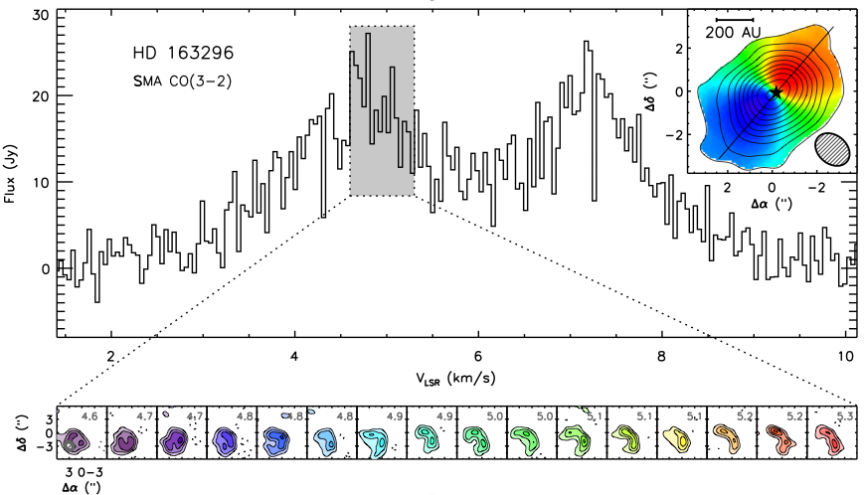
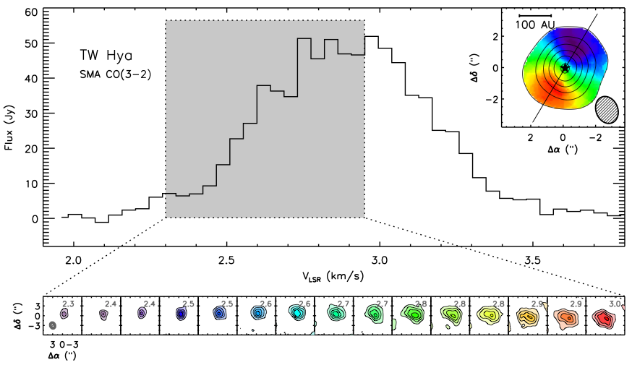
Observations
The HiRes correlator mode on the SMA can achieve a spectral resolution of ~50 m/s, less than the inferred turbulent linewidth of these disks.
Turbulent linewidth ~300 m/s, or ~40% c_{s}
Turbulent linewidth <40 m/s, or <10% c_{s}
Challenge: disentangle sources of broadening (turbulent, thermal, rotation, τ, …)
Hughes et al. (2011)

Slide 12
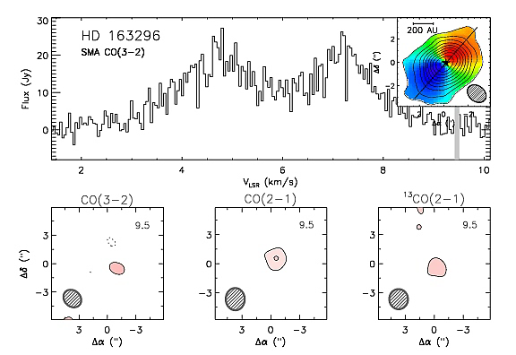
Vertical Profile with Multiple Lines
CO(3-2)
CO(2-1)
Preliminary results: turbulent linewidth decreases towards midplane
¹³CO(2-1)

Slide 13
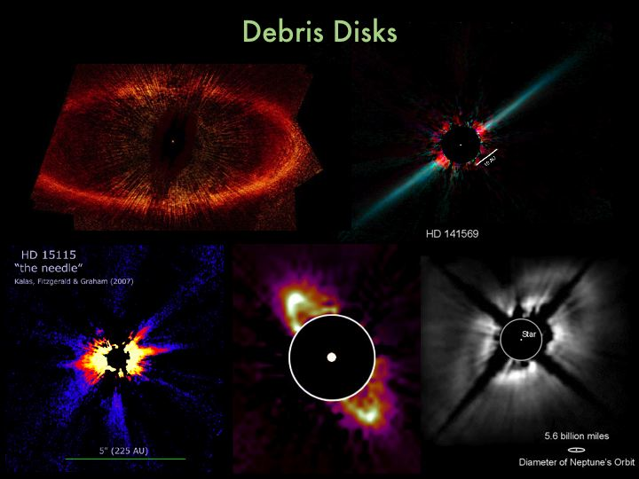
Debris Disks
Structure in Debris Disks
Fomalhaut
Kalas et al. (2005)
AU Mic
Fitzgerald et al. (2007)
HR 4796A
Schneider et al. (1999)
Weinberger et al. (1999)

Slide 14
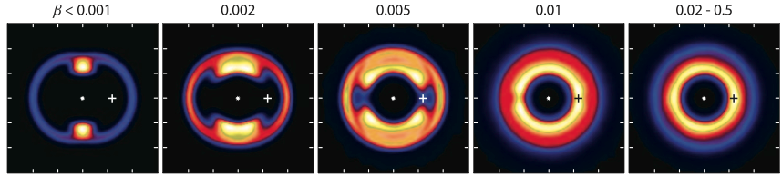
Debris Disks and Millimeter Interferometry
Why Millimeter?
Why Interferometry?
Few stellar radiation effects
Good for tracing parent planetesimal belts and resonances
Can resolve distant sources
Particularly good at picking out clumps and rings
Wyatt (2006)

Slide 15
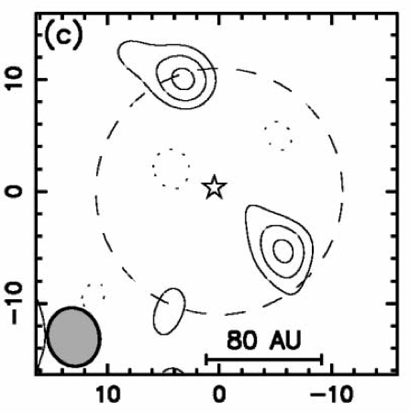
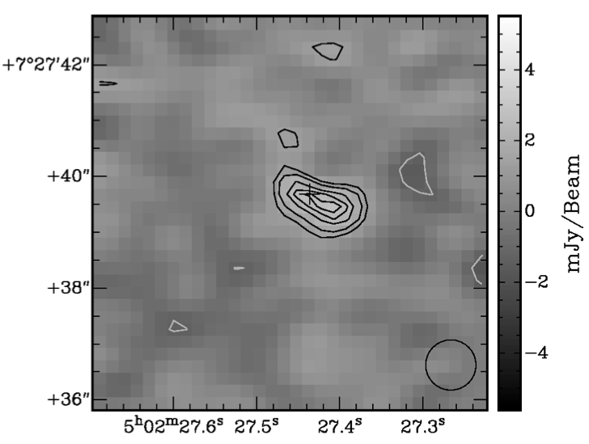
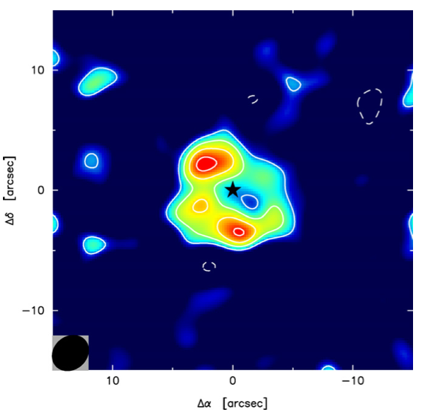
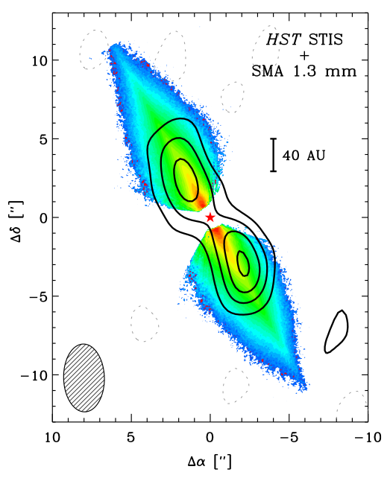
State of the Field (2011)
Disk Detected:
Vega
HD 32297
HD 107146
β Pic
Structure?
Clumpy
Asymmetry?
Clumpy
Possible warp?
Wilner et al. (2002),
Koerner et al. (2001)
Maness et al. (2008)
Corder et al. (2009)
Wilner et al. (2011)

Slide 16
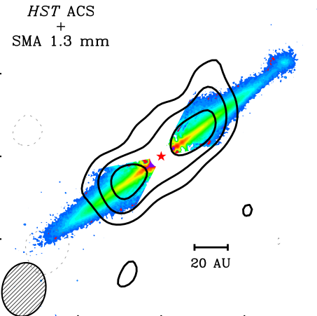
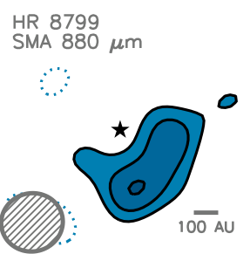
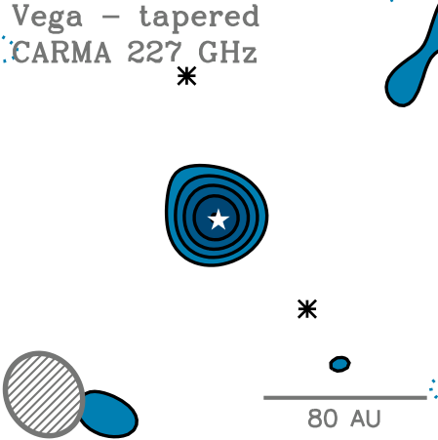
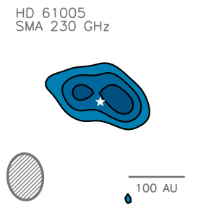
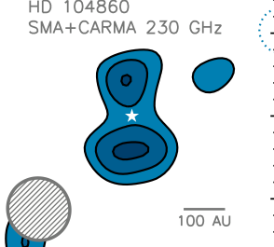
State of the Field (2012)
Disk Detected:
Vega
HD 32297
HD 107146
β Pic
HR 8799
HD 61005
AU Mic
HD 104860
Structure?
Smooth
Asymmetry?
Smooth
Possible warp?
Smooth
Smooth
Smooth
Smooth
Pietu et al. (2011)
Hughes et al. (2012)
Hughes et al. (2011)
Hughes et al. (2011)
Hughes et al. (in prep)
Wilner et al. (2012)
Hughes et al. (in prep)

Slide 17
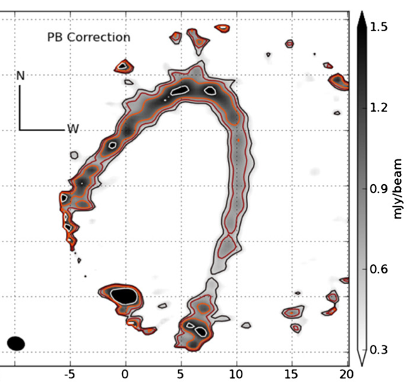
Oh, and this one… (also smooth despite planet)
ALMA data! Fomalhaut (from Boley et al. 2012)

Slide 18
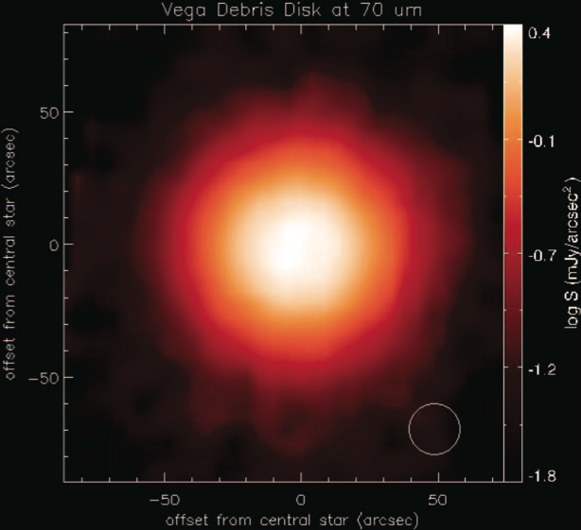
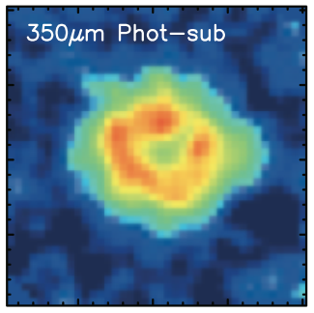
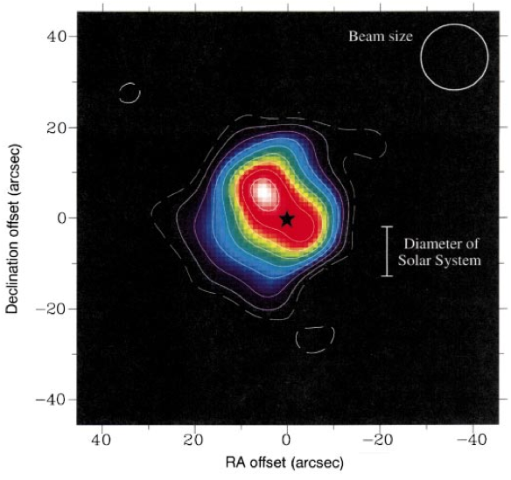
Vega
Su et al. (2005)
Wavelength
Marsh et al. (2006)
Holland et al. (1998)
Wilner et al. (2002)

Slide 19
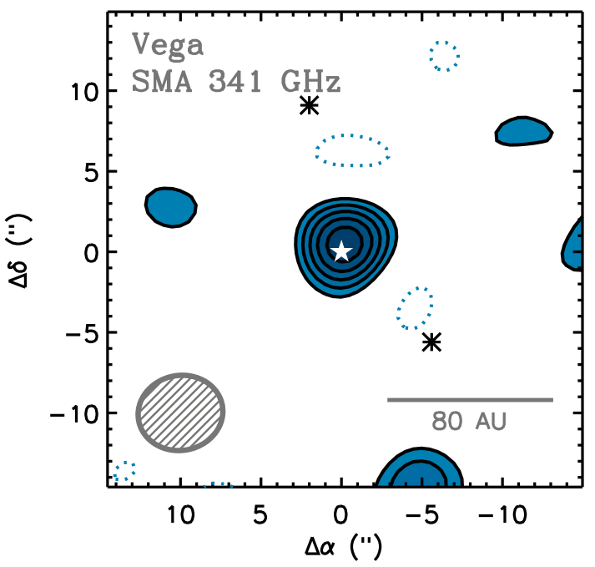
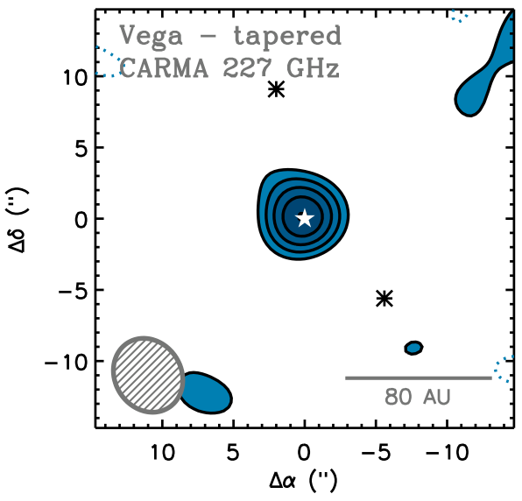
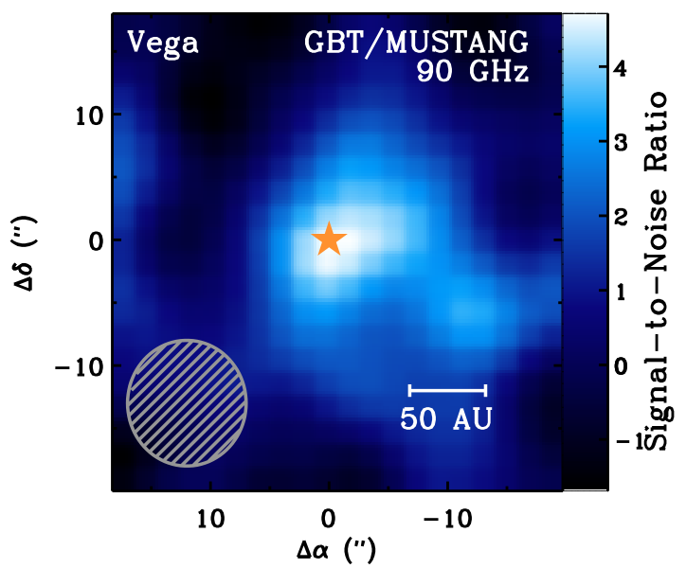
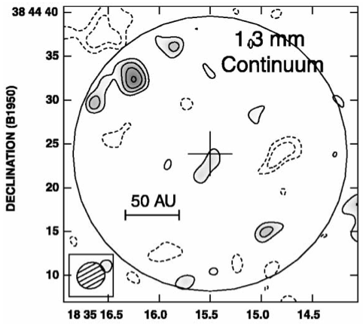
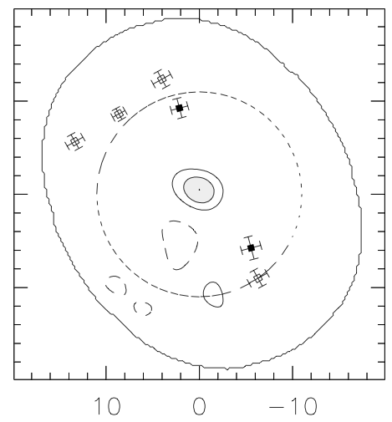
Vega
Koerner et al. (2001)
Wilner et al. (2002)
Pietu et al. (2011)

Slide 20
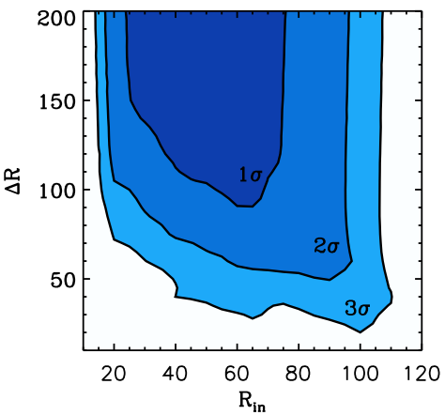
Vega
No detection of disk in SMA/CARMA data
No evidence of bright northeast clump in GBT data
Disk must be large and broad
≤50% of flux distributed in clumpy structures on ≤100AU scales
Hughes et al. (2012)

Slide 21
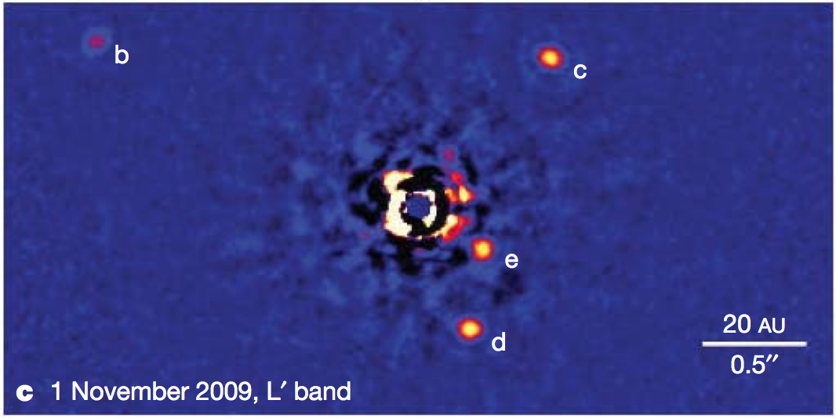
HD 107146 and HR 8799
Sun-like (G2V) star
~100 Myr age
Evidence for planets?
A0V star
~100 Myr age
Hosts ≥4 planets
Marois et al. (2010)
Corder et al. (2009)

Slide 22
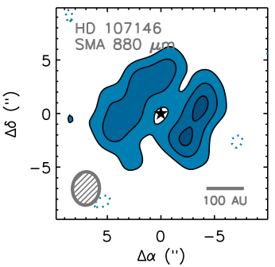
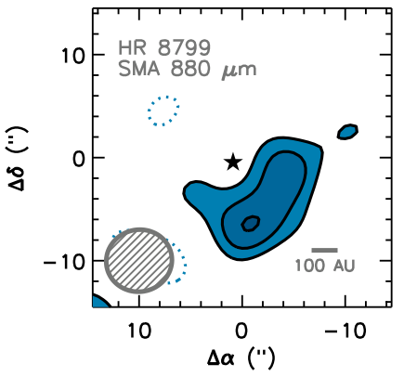
HD 107146 and HR 8799
Broad band 50-170AU
Follows scattered light
No significant asymmetry
K. Su model w/R_{in}~150AU
Broad band of emission
No significant asymmetry
Hughes et al. (2011)

Slide 23
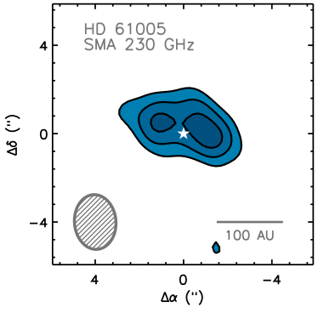
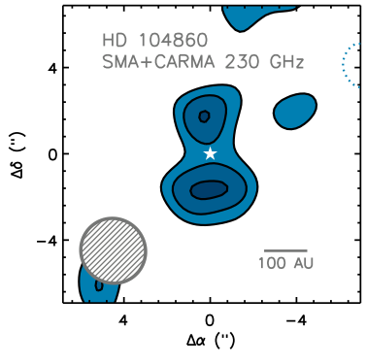
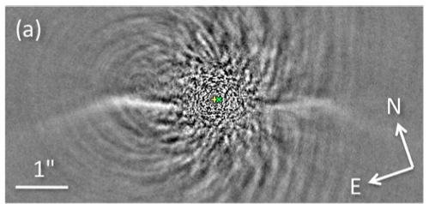
Two FEPS Debris Disks
“The Moth”
Millimeter emission consistent with scattered light ring
HD 104860
First Resolved Image
Buenzli et al. (2010)
Both consistent with smooth, axisymmetric disk emission
In prep, with Angelo Ricarte and Noel Moldvai

Slide 24
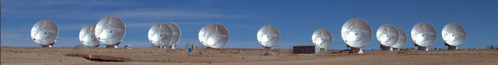
Take-home message #1
Evidence for clumpy mm-λ structures in debris disks is tenuous at best
… SO FAR
At current low S/N levels, it’s all or nothing.
This is rapidly changing!
No clumps does not mean no planets

Slide 25
Take-home message #2
Some disks are broad and some are narrow in the millimeter
(independent of scattered light images)
Wilner et al. (2011)
β Pic/AU Mic support a “birth ring” paradigm
Narrow mm ring, broad scattered light disk
HD 61005 also narrow, swept-back scattering
HD 107146 traces scattered light
Vega and HR 8799 also broad (ΔR≥R)

Slide 26
Summary
Several nondetections of polarized mm emission from T Tauri stars indicates low grain alignment efficiency/B field misalignment
Tentative evidence for a higher pol fraction at younger ages (toroidal)
Initial attempts at measuring turbulence using HiRes mm spectroscopy are broadly consistent with MRI theory
We are building up a vertical profile using different tracers
Interferometric measurements of debris disks are so far consistent with smooth, axisymmetric structure (even in known planet hosts)
We observe much variation relative to scattered light structures

